Slide 1
DATA WRANGLING AND VISULIZATION
HANDS ON FINAL
LESSON 10

Slide 2
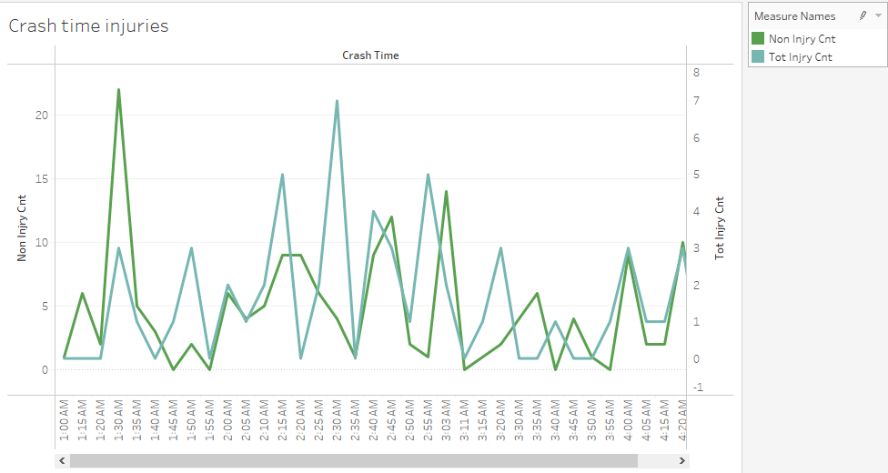
Bars close at 2AM
Peak accidents with injuries after 2AM
Non injury accidents peak before 2AM

Slide 3
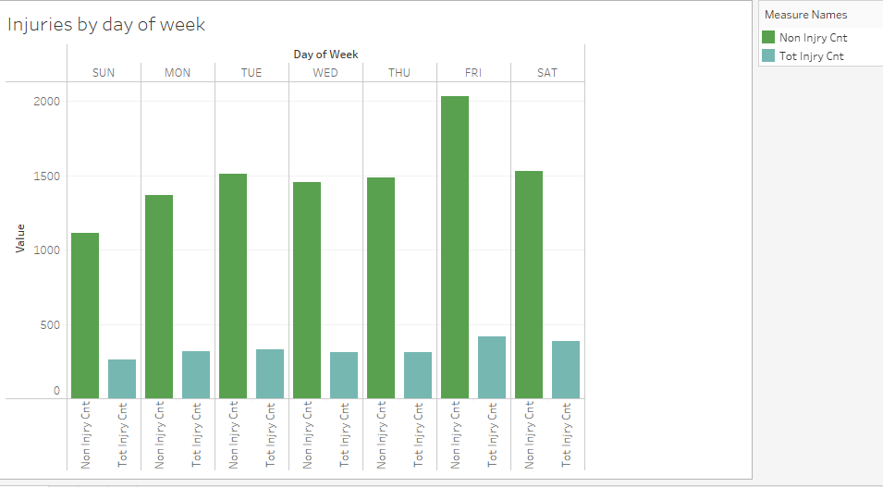
The above slide shows most accidents happen on Friday and Saturday.

Slide 4
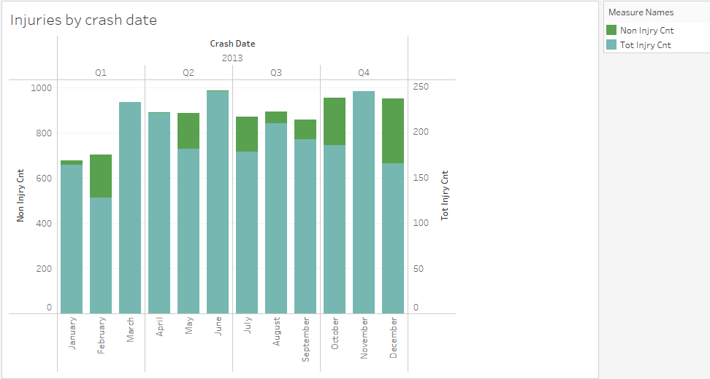
Accidents with injuries seem to happen more in June and November, this could be due to vacations in summer and holiday travel at Thanksgiving.

Slide 5
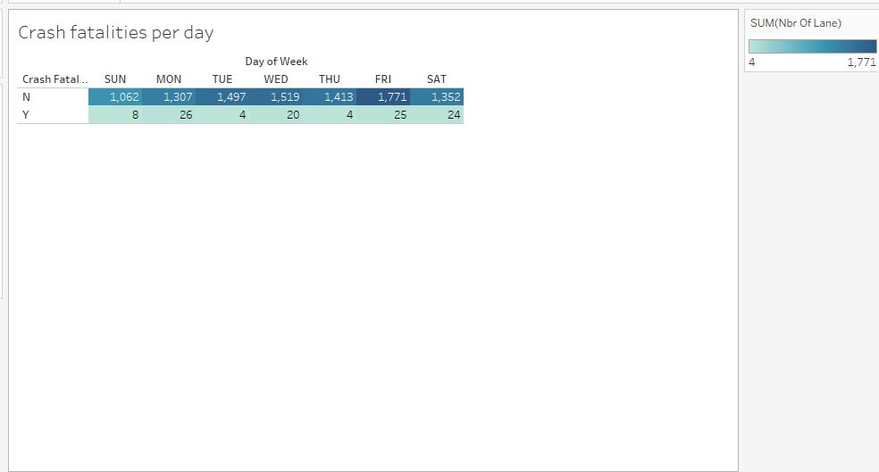
This slide is self explanatory, showing when most fatal crashes happen. Friday and Saturday is to be expected but the most fatalities happened on Monday which is a surpise, especially since more accidents happened on Thursday.

Slide 6
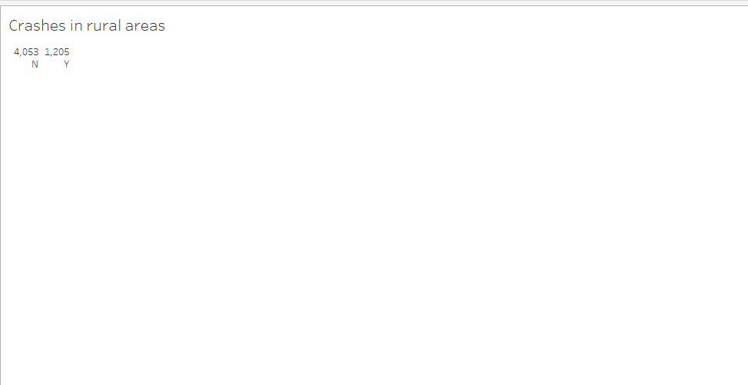
This shows the crashes in rural areas against crashes in non rural areas. It seems that most crashes happen in non rural areas.

Slide 7
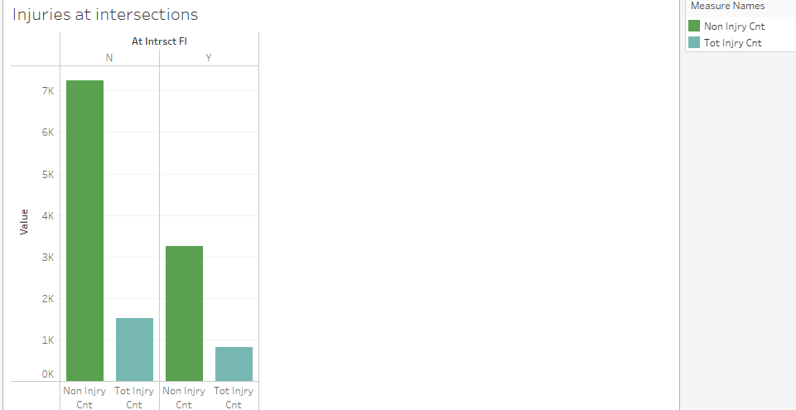
It would be easy to believe that most accidents would happen at intersections but according to this data most accidents do not happen at intersections.

Slide 8
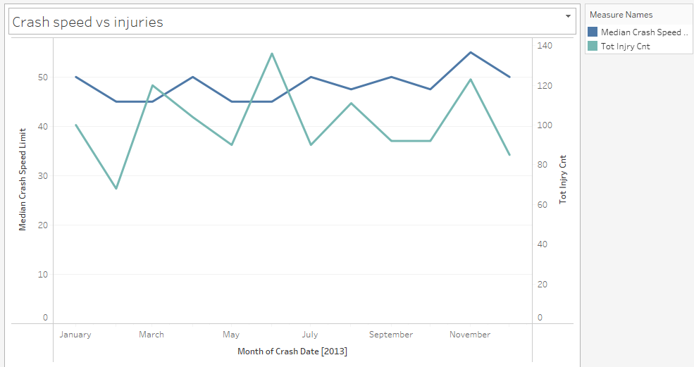
This chart compares the crash speed to total injuries during the crash. The only time the peaks move up at the same time seems to be in November. It also appears most of the crashes happen around 45-50 mph, the highest peak of injuries seem to be around June.

Slide 9
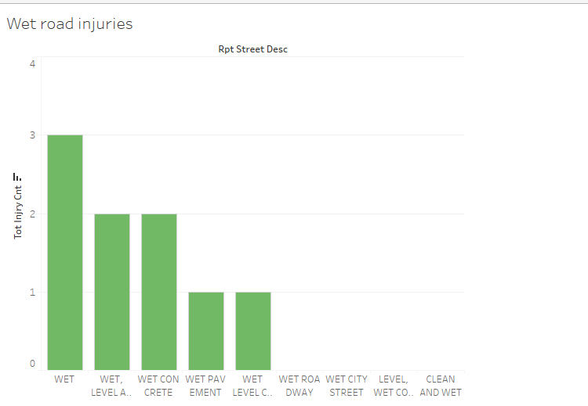
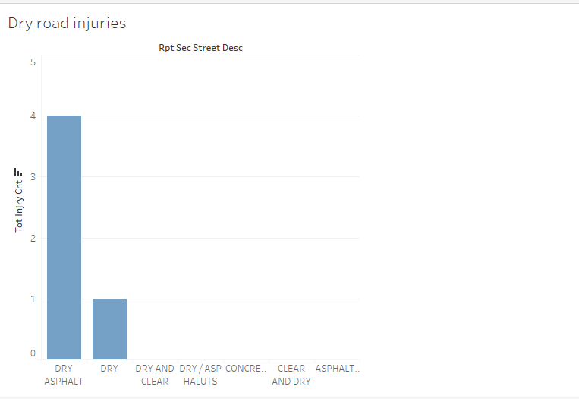
These charts side by side compare if accidents with injuries happen more on wet or dry roads. As you can see, more accidents with injuries happen on wet roads which is what we can expect.

Slide 10
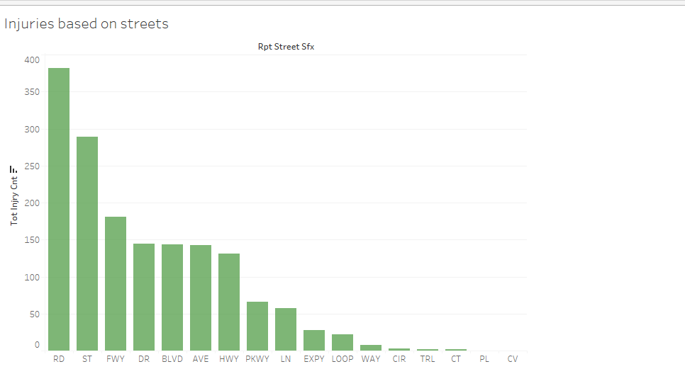
You would think that most accidents with injuries would occur on freeways but according to this data, streets labeled as RD or ST have more injury accidents than freeways. Could this be due to the fact that there are more roads and streets than freeways?

Slide 11
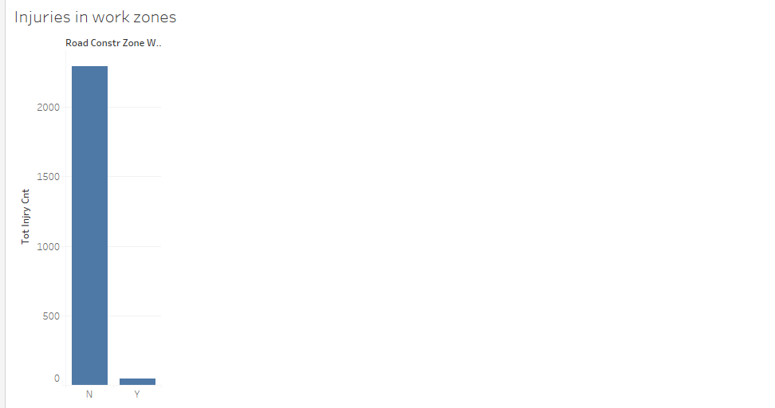
This slide does show some good news, in construction zones with workers present you are less likely to be in an accident that will cause injury. Hopefully this is due to cars slowing down for construction zones.

Slide 12
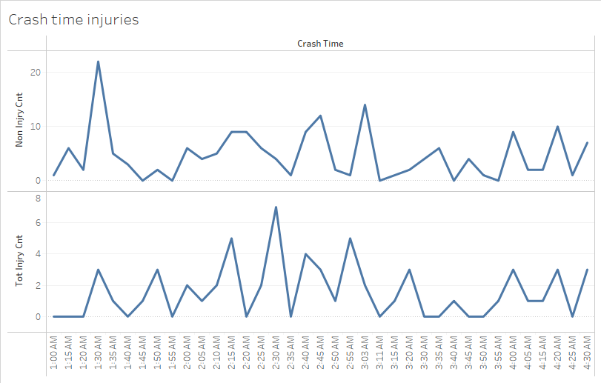
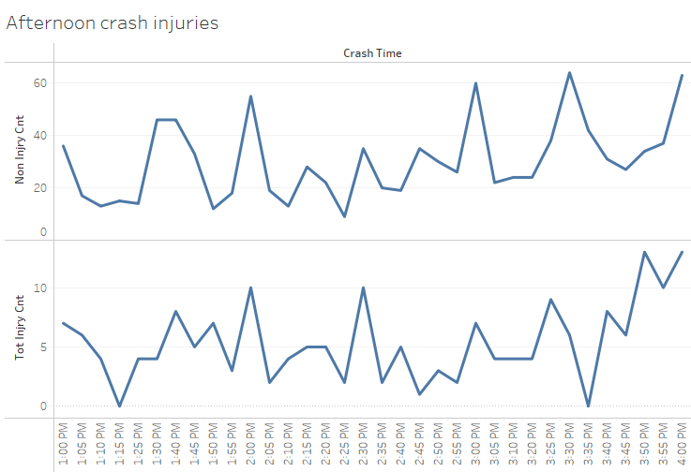
When you place these two graphs together you can compare early morning accidents to afternoon accidents around the same time frame. Around 4 am you have a drop in accidents but around 4pm you have a peak. This is something to be expected as to account for rush hour around the 4 pm time frame.

Slide 13
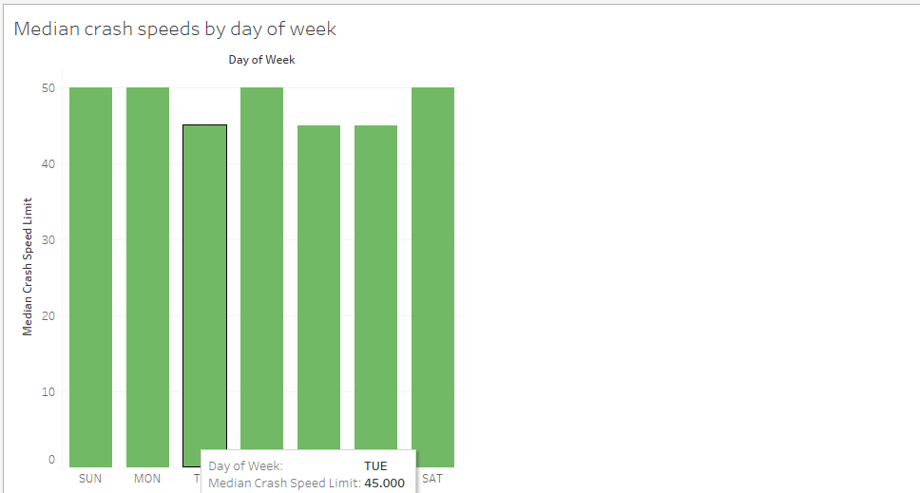
This graph shows the average speed during crashed pr day of the week. It seems that like the previous graph most accidents happen around 45-50mph.

Slide 14
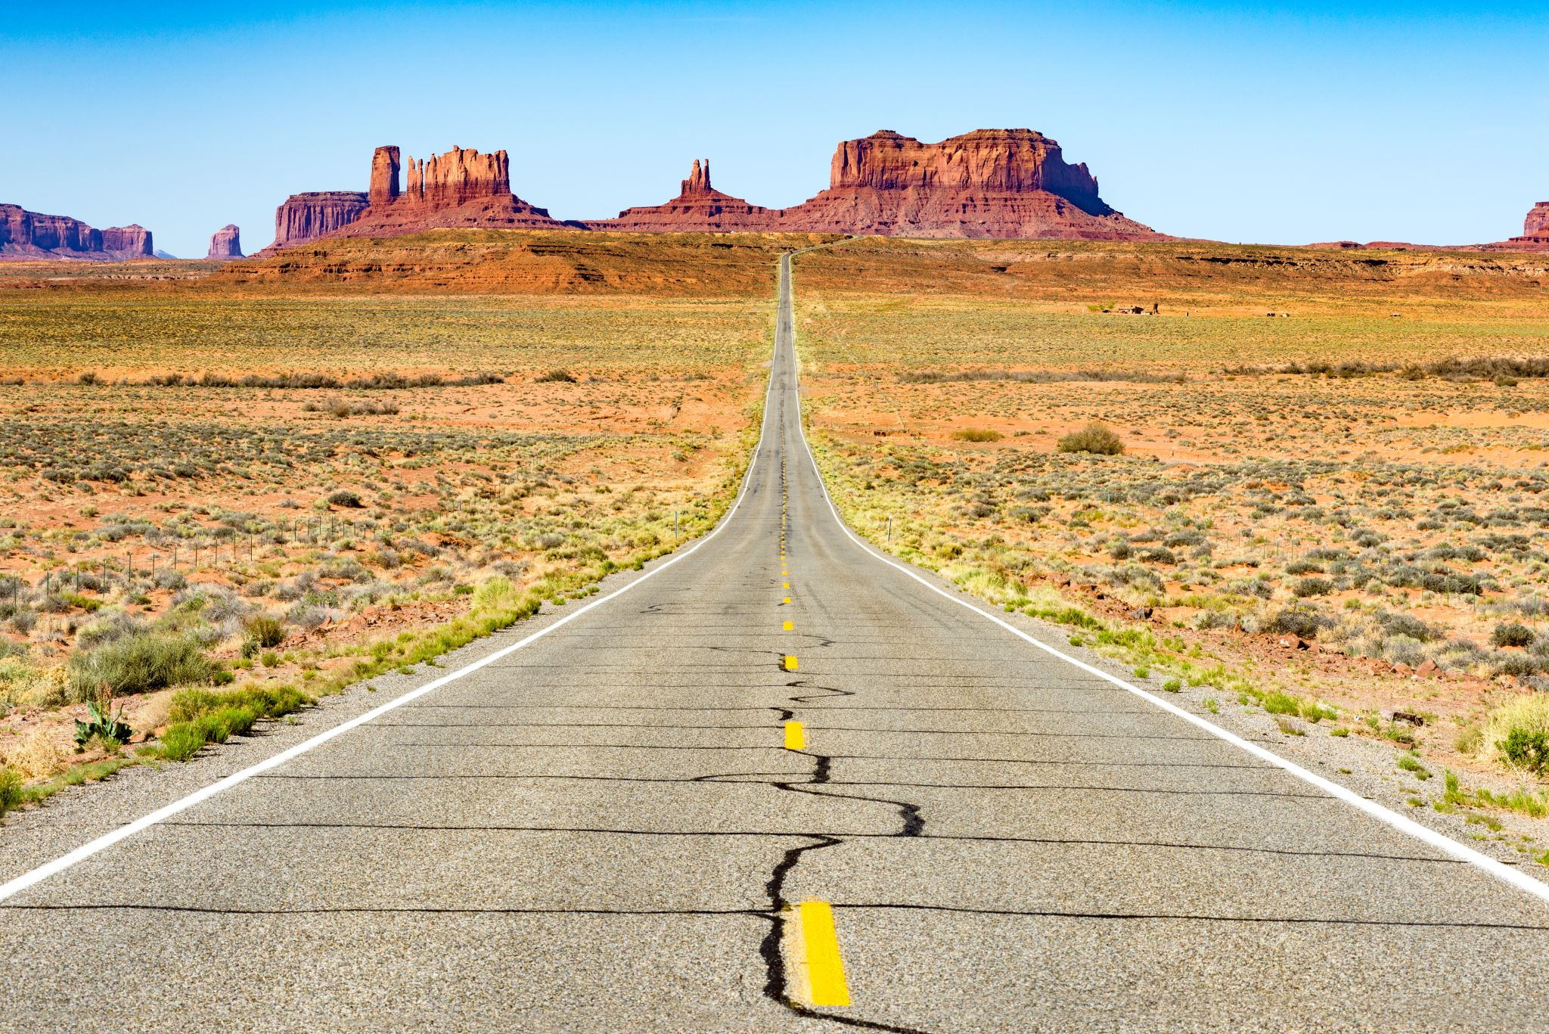
In conclusion, I think we can all agree that driving is a dangerous act. In Texas 232,656 persons were injured in motor vehicle traffic crashes in 2013. The best time to travel safely is Tuesday or Thursday when the road conditions are dry.
During 2013, more DUI - Alcohol crashes were reported in the hour between 2:00 am and 2:59 am than any other hour of the day. Also, more of these crashes occurred on Saturday than any other day of the week.

